Slide 1
CPU Offload
Applications and Value
CPU has gradually become the bottleneck of computing and management in large distributed networks. Compared to other hardware, there is little improvement in the performance of CPU, and server CPU cycles and memory bandwidth have become precious commodities. To satisfy the needs of high performance computing, current practical solutions are about offloading some of the CPU tasks to relevant devices in cloud, network and/or clients. Using SmartNIC (smart network interface card) and RDMA (Remote Direct Memory Access) are prominent. However, offloading to different hardware leads to different challenges.
In multi-tenant systems, the CPU overhead of distributed file systems (DFSes) is increasingly a burden to application performance [8].
CPU and memory interference cause degraded and unstable application and storage performance for operation latency.
DFS offload to SmartNICs is a promising solution to these problems, but it is challenging to fit the complex demands of a DFS onto simple SmartNIC processors located across PCIe.
An efficient solution with pipeline parallelism is proposed [1].
RDMA requires CPU intervention for complex ofﬂoads that go beyond simple remote memory access. Thus, its ofﬂoad potential is limited and RDMA-based systems usually have to work around such limitations.
To support complex ofﬂoads, the networking community has developed SmartNIC architectures. SmartNICs incorporate more powerful compute capabilities via CPUs or FPGAs.
However, SmartNICs are not ubiquitous, and their smaller volume implies a higher cost. SmartNICs can cost up to 5.7× more than commodity RDMA NICs (RNICs) at the same link speed.
Due to custom architecture, SmartNICs are also management burden to the system operator.
A Turning Complete RDMA based method for complex ofﬂoad is developed in [4].
TCP remains the default protocol in many networks, but its CPU overhead is a burden to performance.
Even with a long line of improvements and optimizations, communication-intensive applications spend up to 48% of per-CPU cycles in the TCP stack and NIC driver.
[3] introduced a TCP offload engine (TOE) to SmartNICs.
More relevant papers:
[12]https://homes.cs.washington.edu/~arvind/papers/e3-smartic.pdf
[13] https://www.usenix.org/system/files/fast21-neal.pdf
[14] https://www.usenix.org/system/files/osdi18-phothilimthana.pdf
[8] https://homes.cs.washington.edu/~arvind/papers/ipipe.pdf

Slide 2
LineFS: Efficient SmartNIC Offload of a Distributed File System with Pipeline Parallelism [1, 2]
Challenges
Methods
1. Persistent memory (PM, between memory and storage, gains popularity by reducing access latency [6]) optimized distributed file systems (DFSes) shares CPU and memory resources with applications to reduce PM access latency.
2. Unfortunately, the low-latency access comes with the cost of CPU competition with applications and causes high CPU utilization and performance interference during data movement and indexing, replication, Remote storage access requests, file system consistency, etc.
3. The interference leads to unpredictable application performance, unpredictable file system access latency and tail-latency, reduced throughput, etc.
4. Offload of DFS services to a SmartNIC can be a solution to the aforementioned problems, but still with efficiency challenges: 1) High Peripheral Component Interconnect Express (PCIe, a interconnect that CPUs enjoy to access memory) latency; 2) Permission checks and validation consume enough computational bandwidth to saturate the SmartNIC processors; 3) Naive SmartNIC offload (every RDMA connection has an independent polling thread) overloads SmartNIC CPUs; 4) Replication processing needs to be parallelized and scale to many SmartNIC CPUs (and their connections) to achieve low latency and high throughput on wimpy SmartNIC architecture.
LineFS offloads CPU-intensive DFS tasks (e.g., replication, compression, data publication, index and consistency management) to a SmartNIC. Hide execution and data access latencies by exploiting opportunities for parallelization, batching, and asynchronous operation. Specifically:
1. A persist-and-publish model that separates PM storage operations on the critical-path from operations that can execute asynchronously.
2. A parallel data-path execution pipeline to speed up asynchronous publishing operations.
3. Decompose DFS operations into distinct execution stages that operate in a parallel pipeline, which keeps operations for consistency.
4. To avoid pipeline execution stalls, prefetch data across PCIe and organize host data structures into pipeline chunks that can be transmitted in bulk and processed in parallel.
Results
Implement LineFS on the Mellanox BlueField SmartNIC [7] and compare it to Assise (a state-of-the-art PM DFS):
1. Improves latency in LevelDB up to 80% and throughput in Filebench up to 79%, while providing extended DFS availability during host system failures (LevelDB and Filebench are application benchmarks).
2. In the presence of an interfering (CPU-intensive workload), 227% better.
3. Enable new functionality, such as compressing data while running a sorting benchmark, 11% better performance than the no-compression case, saving considerable network bandwidth up to 72%.
4. Increase system availability during host failure.
[1] https://www.cs.utexas.edu/users/witchel/pubs/kim21sosp-linefs.pdf
[2] https://github.com/casys-kaist/LineFSs
[6] https://www.snia.org/education/what-is-persistent-memory
[7] https://www.mellanox.com/products/BlueField-SmartNIC-Ethernet

Slide 3
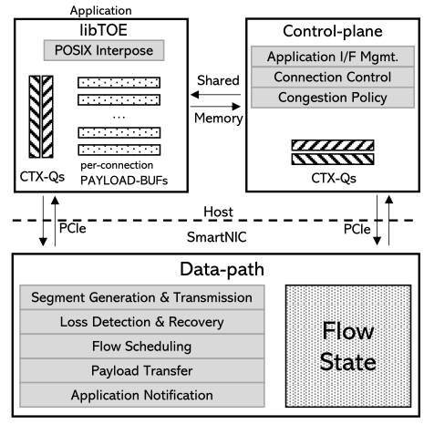
FlexTOE: Flexible TCP Offload with Fine-Grained Parallelism [3]
I. Challenges
II. Methods
Offload is a promising solution for reduction of CPU overhead. However, full TCP offload engines (TOEs) are not popular because fixed hardware offloads limit protocol evolution after deployment [11]. Challenges of TCP data-path offload to SmartNICs：
1. SmartNICs support only restrictive programming models but handle massive parallelism with wimpy cores.
2. Offload has to mask high-latency operations that cross PCIe.
3. TCP requires computationally intensive and stateful code paths to track segments and to perform congestion control.
4. For each connection, TCP data-path needs to provide low processing tail latency and high throughput and is also extremely sensitive to reordering.
Focus on scenarios in data centers (connections are long-lived and small individual transfers due to remote procedure calls are processing intensive).
1. Analyze the CPU overhead of TCP data-path processing for common data center applications, Table 1 in [3].
2. Design first full TCP data-path offload to network processor (NPU) SmartNICs, FlexTOE:
1) FlexTOE offloads the TCP data-path to a NPU based SmartNIC, enabling full customization of transport logic and flexibility to implement features whose requirements change frequently in data centers.
Figure 1: FlexTOE off load architecture [3]
III. Results
FlexTOE is a flexible and high-performance TCP offload engine to SmartNICs. FlexTOE leverages data-path processing with fine-grained parallelism for performance, but remains flexible via a modular design:
1. Memcached scales up to 38% better on FlexTOE versus TAS, while saving up to 81% host CPU cycles versus Chelsio.
2. FlexTOE provides competitive performance for RPCs, even with wimpy SmartNICs.
3. FlexTOE cuts 99.99th-percentile RPC RTT by 3.2 × and 50% versus Chelsio and TAS, respectively, 27% higher throughput than Chelsio for bidirectional long flows, and an order of magnitude higher throughput under 2% packet loss than Chelsio.
4. FlexTOE maintains high performance when interoperating with the other network stacks.
2) Eliminates almost all host TCP processing in common data center scenarios.
3) Target offload at TCP data transport of established connections, avoiding complex control logic in the NIC.
4) Offloaded data-path is one-shot for each TCP segment, i.e., segments are never buffered in the NIC.
5) Decompose TCP data-path into fine-grained modules that keep private state and communicate explicitly to provide scalability and flexibility, .
6) FlexTOE modules leverage a data parallel execution model that maximizes SmartNIC resource use and simplifies customization.
7) Organize FlexTOE modules into a data-parallel computation pipeline.
8) Reorder segments on-the-fly to support parallel, out-of-order processing of pipeline stages, while enforcing in-order TCP segment delivery.
9) Interoperates well with other TCP stacks and is robust under adverse network conditions.
[3] https://arxiv.org/abs/2110.10919
[11] https://dl.acm.org/doi/10.1145/1005062.1005069

Slide 4
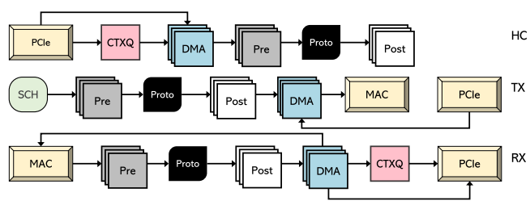
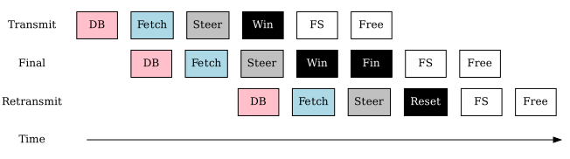
FlexTOE: Flexible TCP Offload with Fine-Grained Parallelism [3]
II. Methods(supplementary)
In order to reduce CPU overhead because of TPC processing, FlexTOE first splits the network stacks to libTOE, Control Plane和Data-Path (as shown below), where data-path is offloaded to SmartNIC; data-path is further decomposed into five-stage parallel pipeline of processing modules for fine-grained Parallelism.
HC, TX, and RX are 3 workflows in data-path
Use HC workflow as an example, the fine-grained parallelism with modules
Note that each color (pink, blue, black, white, gray) represents a module
[3] https://arxiv.org/abs/2110.10919
Figure 1: FlexTOE off load architecture [3]

Slide 5
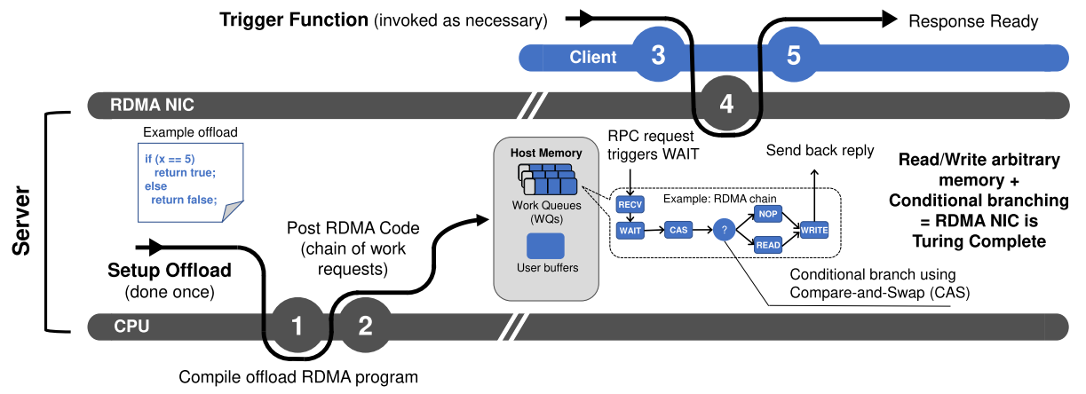
RDMA is Turing complete, we just did not know it yet! [4, 5]
II. Methods
I. Challenges
1. how to use RDMA NICs (RNICs) interface that only consists of simple data movement verbs (READ, WRITE, SEND, RECV, etc.) and no conditionals or loops, to realize complex ofﬂoads.
2. A general solution that can be used to build complex RDMA programs and perform a wide range of functionality.
3. A solution that is efﬁcient and robust to performance variability properties of using RNICs for complex ofﬂoads.
4. Integrate complex RNIC ofﬂoads with existing applications.
Figure 1: RDMA NICs can implement complex ofﬂoads if we allow conditional branches to be expressed [4].
1. Show that commodity RDMA NICs are Turing complete (a system of data-manipulation rules, such as a computer's instruction set, that can be used to simulate any Turing machine, i.e., this system is able to recognize or decide other data-manipulation rule sets [10]), so it can use RNICs to implement complex offloads.
2. Present RedN, a principled and practical approach to implementing complex RNIC ofﬂoads:
1) develop building blocks that lift the existing RDMA verbs interface to a Turing complete set of programming abstractions by using self-modifying RDMA programs.
2) ofﬂoad complexity and performance with just a commodity RNIC using these abstractions.
3) integrate complex RNIC ofﬂoads, developed with RedN principles, into existing networked applications.
III. Results
1. Commodity RNICs are Turing-complete and can perform complex ofﬂoads without any hardware modiﬁcations.
2. Provide a practical way to implement complex NIC ofﬂoads on RNICs, without the burden of acquiring and maintaining SmartNICs.
3. Achieve up to 2.6× and 35× speed-up versus state-of-the-art RDMA approaches, for key-value get operations under uncontended and contended settings, respectively, while allowing applications to gain failure resiliency to OS and process crashes.
4. Opens the door for a wide variety of innovations in RNIC ofﬂoading, which can help guide the evolution of the RDMA standard.
[4] https://arxiv.org/abs/2103.13351 [5] https://redn.io
[9] http://www.rdmaconsortium.org/ [10] https://en.wikipedia.org/wiki/Turing_completeness

Slide 6
RDMA is Turing complete, we just did not know it yet! [4, 5]
II. Methods (supplementary)
Turning Complete requirement #1, satisfied with regular verbs
CPU Offload by RNIC
Turning Complete requirement # 2，realized by CAS
1. Show that commodity RDMA NICs are Turing complete, thus, it can be used to substitute SmartNIC.
2.Because if/else is not readily available in RDMA, the authors used self-modifying CAS verbs to satisfy Turning Complete requirement. For example, if R1 (old field) has 01, and R2 (id field) has the same 01, i.e., R1 is equivalent to R2, then do WRITE operation, otherwise return default value. The existing RDMA verbs interface is lifted to a Turing complete set of programming abstractions.
[4] https://arxiv.org/abs/2103.13351
[5] https://redn.io

Slide 7
卸载(Offload)CPU任务
应用场景及商务价值
CPU本身处于分布式大规模计算和调度的瓶颈状态。相对于其它硬件，如网络和存储设备，CPU性能改进不大，以至于服务器 CPU的周期和内存带宽已成为宝贵的资源。为跟上计算要求，目前比较实际的解决方案是把CPU的一些任务分摊(offload)到端管云相应的硬件上。使用SmartNIC (smart network interface card)和RDMA (Remote Direct Memory Access)是流行的办法。然而，offload到不同硬件会有不同的问题。
在多用户系统中，分布式文件系统 (Distributed File Systems, DFSes) 的 CPU 开销渐成为应用程序运行负担 [8]。
CPU和内存干扰导致应用和存储性能下降和不稳定，尤其是操作延迟。
将DFS 卸载到SmartNIC是一个有效的解决方案，
但是将DFS复杂的需求置于简陋的位于PCIe 上的SmartNIC处理器是一项挑战。
文章[1]提供了一个带并行流水线的有效解决方案。
许多网络中仍然默认使用TCP协议，即使其CPU开销越来越成为应用程序性能的负担。
即使经过长期的改进和优化，通信密集型应用程序仍需花费高达48%的每个CPU周期在TCP 堆栈和NIC驱动程序中。
文章[3]介绍了一个带细粒度并行性的解决方法。
RDMA需要CPU干预来处理超出简单远程内存访问的复杂卸载。例如，许多基于RDMA的系统需要多次网络往返或重新引入服务器CPU的参与来执行远程数据结构遍历和哈希表访问等请求。因此，基于RDMA的系统通常需要绕过这些限制。
为了支持复杂的卸载，网络社区开发了许多 SmartNIC 架构。 SmartNIC通过CPU或FPGA整合了较强大的计算能力。
然而，SmartNIC并不普遍，它们的小量使用意味着更高的成本。 SmartNIC的成本最高比具有相同链接速度的低廉RDMA NIC (RNIC)高达5.7倍。
由于他们的定制架构，他们也是系统操作员的管理负担。
文章[4]设计了一个用低廉的但图灵完整的RDMA实现SmartNIC卸载复杂CPU任务的方法。
[8] https://homes.cs.washington.edu/~arvind/papers/ipipe.pdf
更多相关文章:
[12] https://homes.cs.washington.edu/~arvind/papers/e3-smartic.pdf
[13] https://www.usenix.org/system/files/fast21-neal.pdf
[14] https://www.usenix.org/system/files/osdi18-phothilimthana.pdf

Slide 8
LineFS: 带并行流水线的有效的分布式文件系统的SmartNIC卸载 [1, 2]
技术挑战
创新方案
1. 持久内存(persistent memory, PM, 位于内存和存储之间，可减少访问延迟 [6])优化后的分布式文件系统 (distributed file systems, DFSes)与应用程序共享 CPU 和内存资源，以减少 PM 访问延迟。
2. 然而，低延迟访问伴随着与应用程序竞争CPU，并在数据移动和索引、复制、远程存储访问请求、文件系统一致性等过程中引起CPU 利用率和性能干扰。
3. 干扰将导致不可预测的应用程序性能、不可预测的文件系统访问延迟和尾延迟、吞吐量降低等。
4. 将DFS服务卸载到SmartNIC可以解决上述问题，但仍然存在效率挑战：
高外围组件互连(Peripheral Component Interconnect Express, PCIe, 利于CPU访问内存的互连)延迟;
权限检查和验证会消耗足够的计算带宽以至SmartNIC处理器饱和；
单纯的SmartNIC卸载(每个RDMA连接都有一个独立的轮询线程)会过载SmartNIC CPU;
复制处理需要并行化并扩展到多个SmartNIC CPU及其连接上, 以在弱小的 SmartNIC 架构上实现低延迟和高吞吐量。
LineFS将CPU 密集型DFS任务(如，重复、压缩、数据发布、索引和一致性管理)卸载到SmartNIC，并通过利用并行化、批处理和异步操作来减少执行和数据访问延迟。具体来说:
1. 一个持久发布的模型：将关键路径上的 PM 存储操作与可以异步执行的操作分开的。
2. 一个并行数据路径执行流水线(pipeline)，以加快异步发布操作。
3. 将 DFS 操作分解到不同的执行阶段，以在并行管道中运行，从而保持操作的一致性。
4. 为避免流水线执行停顿，跨 PCIe 预取数据并将主机数据结构组织成流水线块，从而批量传输和并行处理。
技术价值
在Mellanox BlueField SmartNIC[7]上实现LineFS, 并将其与Assise(目前最先进的 PM DFS)比较得出：
1. 将LevelDB中的延迟改进多达80%, 将Filebench中的吞吐量提高多达79%，(LevelDB 和 Filebench 是应用程序基准), 同时在主机系统故障期间提供扩展了的DFS可用性。
2. 存在干扰时(CPU 密集型工作负载)，性能提高 227%。
3. 带来新功能，例如运行基准排序同时压缩数据，性能比无压缩情况提高 11%，以及节省高达72%的网络带宽。
4. 增加主机故障时的系统可用性。
[1] https://www.cs.utexas.edu/users/witchel/pubs/kim21sosp-linefs.pdf
[2] https://github.com/casys-kaist/LineFSs
[6] https://www.snia.org/education/what-is-persistent-memory
[7] https://www.mellanox.com/products/BlueField-SmartNIC-Ethernet

Slide 9
FlexTOE: 带细粒度并行性的灵活TCP卸载[3]
I. 技术挑战
II. 技术创新
卸载是减少 CPU 开销的有效解决方案。然而，完整的TCP卸载引擎 (TOE) 并不流行，因为固件卸载限制了发布后的协议演进 [11]。 TCP 数据路径卸载到 SmartNIC 的挑战包括[11]：
1. SmartNIC仅支持限制性编程模型，但需要在简陋的核处理大规模并行。
2. 卸载必须屏蔽跨 PCIe 的高延迟操作。
3. TCP 需要计算量密集的且分布的代码路径来跟踪段并执行拥塞控制。
4. 对于每个连接，TCP 数据路径需要提供低处理尾延迟和高吞吐量，并且对重新排序极其敏感。
专注于数据中心的场景（即，由于密集型的远程调用，连接属于长期存在的，小型的单个传输）。
1. 作者先分析常见数据中心应用程序的TCP 数据路径处理的 CPU 开销，详情见[3] 中的表 1。
2. 设计了第一个完整的TCP数据路径卸载到网络处理器 (network processor, NPU) SmartNIC, FlexTOE：
1) FlexTOE 将 TCP 数据路径卸载到基于 NPU 的 SmartNIC，实现传输逻辑的完全定制和执行特征的灵活性，这些特征需求在数据中心频繁多变。
2）去除了常见数据中心场景中几乎所有的主机TCP处理。
III. 技术价值
FlexTOE是一个针对SmartNIC的灵活的高性能的TCP 卸载引擎。FlexTOE 利用具有细粒度并行性的数据路径处理来提高性能，但通过模块化设计保持灵活性：
1. 与 TAS 相比，Memcached在FlexTOE上提高了多达38%；与 Chelsio 相比，节省了多达81% 的主机CPU周期。
2. FlexTOE为远程过程调用(remote procedure call, RPC)提供了具有竞争力的性能，即使是简陋的 SmartNIC。
3. 与 Chelsio 和 TAS 相比，FlexTOE将 99.99th-百分位RPC 往返时间(round-trip time, RTT)分别降低了3.2 倍和50%；对于双向长流量，吞吐量比Chelsio 高 27%；在 2% 丢包率下，吞吐量比Chelsio高一个数量级。
4. FlexTOE在与其他网络堆栈互操作时保持高性能。
图 1: FlexTOE 卸载架构 [3]
3) 主要卸载于已建立连接的TCP数据传输，避免 NIC 中复杂的控制逻辑。
4) 卸载的数据路径对于每个 TCP 段都是一次性的，即，段永远不会在NIC中缓冲。
5) 将TCP数据路径分解为细粒度的模块，这些模块保持私有状态并采用显式通信以提供可扩展性和灵活性。
6) FlexTOE模块利用数据并行模型，最大限度地利用SmartNIC资源并简化定制。
7) 将FlexTOE模块组织到数据并行计算管道。
8) 动态段重排以支持并行无序流水线分步处理，同时保证按顺序传送TCP段。
9) 与其他 TCP 协议栈的互操作性很好，在不利的网络条件下也很灵活。
[3] https://arxiv.org/abs/2110.10919
[11] https://dl.acm.org/doi/10.1145/1005062.1005069

Slide 10
FlexTOE: 带细粒度并行性的灵活TCP卸载[3]
II. 技术创新(补充)
由于TCP 数据路径处理消耗CPU，FlexTOE先把相应操作分成3大块(如下图)libTOE, Control Plane和Data-Path，其中Data-path那部分offload到SmartNIC；再把data-path的工作流程(workflows)细分成5个模块(modules)，根据模块流程进行最大化细粒度平行处理。
Data-path有HC, TX,和 RX三个主要的工作流程
以HC工作流程为例子，对模块进行细粒度并行的流水线处理
注：每种颜色(红，蓝，黑，白，灰)对应上面的一个模块
图 1: FlexTOE 卸载架构 [3]
[3] https://arxiv.org/abs/2110.10919

Slide 11
RDMA已经是图灵完整的，只是之前我们不知道而已！[4, 5]
I. 技术挑战
II. 技术创新
1.如何使用由简单的数据移动动词（READ、WRITE、SEND、RECV等）组成，没有条件或循环的RDMA NIC(RNIC)接口去实现复杂的卸载。
2. 可用于构建复杂 RDMA 程序并执行多种功能的通用解决方案。
3. 一个有效的，且对使用 RNIC 进行复杂卸载的性能可变性稳健的解决方案。
4. 将复杂的 RNIC 卸载集成到现有应用程序。
III. 技术价值
1. 低廉的RNIC是图灵完整的，无需任何硬件修改即可执行复杂的卸载。
2. 提供一种在 RNIC 上实现复杂 NIC 卸载的实用方法，无需购买和维护 SmartNIC。
3. 与最先进的 RDMA 方法相比，在非竞争和竞争设置下的键值获取操作分别实现高达 2.6 倍和 35 倍的加速，同时允许应用程序获得对操作系统和进程崩溃的故障恢复能力.
4. 为基于RNIC 卸载的各种创新打开了大门，并帮助指导 RDMA 标准的发展。
Figure 1: 在允许表达条件分支时，RDMA NIC 可以实现复杂的卸载 [4].
1. 证明低廉的RNIC 是图灵完整的(图灵完整是指一种数据操作规则系统，如计算机的指令集，可用于模拟任何图灵机，即该系统能够识别或决定其他数据操作规则集 [10])，因此可用来实现复杂的卸载。
2. 设计RedN，一种实现复杂 RNIC 卸载的实用方法：
1) 开发构建块，通过使用自修改RDMA 程序将现有的RDMA运行指令接口提升到图灵完整的编程抽象集。
2) 通过抽象集，用低廉的RNIC卸载复杂度和性能。
3) 将使用RedN开发的复杂RNIC卸载集成到现有的网络应用程序中。
[4] https://arxiv.org/abs/2103.13351
[5] https://redn.io
[9] http://www.rdmaconsortium.org/
[10] https://en.wikipedia.org/wiki/Turing_completeness

Slide 12
RDMA已经是图灵完整的，只是之前我们不知道而已！[4, 5]
II. 技术创新 (补充)
图灵完整条件1, 通过RDMA自带指令可实现
通过RNIC实现CPU Offload的过程
图灵完整条件2，需要另外设计CAS指令实现
1.证明了RMDA 是图灵完整的，所以低廉的RMDA NIC可实现昂贵的SmartNIC的功能；
2. 但RMDA NIC没有自带if/else执行功能(图灵机器需要能实现if/else)，作者增加比较-转换(Compare-and-Swap, CAS)相关指令去实现if/else。简单化例子：保存数据01，如果下一数据(重复)同为01，通过比较知道其相同(1)，1指向执行指令A，若不同为0指向执行指令B。通过增加CAS指令，RNIC整个指令集是图灵完整的编程抽象集。实现过程配合了其它的一些处理，例如确保work requests(WRs)的顺序，不会被预取(prefetch)等。
[4] https://arxiv.org/abs/2103.13351
[5] https://redn.ios

